Slide 1
Multi-Task Learning(MTL) for Deep Learning

Slide 2
What is Multi-Task Learning?
Multi-Task learning is a sub-field of Machine Learning that aims to solve multiple different tasks at the same time, by taking advantage of the similarities between different tasks. This can improve the learning efficiency and also act as a regularizer
Formally, if there are n tasks (conventional deep learning approaches aim to solve just 1 task using 1 particular model), where these n tasks or a subset of them are related to each other but not exactly identical, Multi-Task Learning (MTL) will help in improving the learning of a particular model by using the knowledge contained in all the n tasks.

Slide 3
Intuition behind Multi-Task Learning (MTL):
By using Deep learning models, we usually aim to learn a good representation of the features or attributes of the input data to predict a specific value.
Formally, we aim to optimize for a particular function by training a model and fine-tuning the hyperparameters till the performance can’t be increased further.

Slide 4
Intuition behind Multi-Task Learning (MTL):
By using MTL, it might be possible to increase performance even further by forcing the model to learn a more generalized representation as it learns (updates its weights) not just for one specific task but a bunch of tasks.
Biologically, humans learn in the same way. We learn better if we learn multiple related tasks instead of focusing on one specific task for a long time.

Slide 5
MTL as a regularizer:
In Machine Learning, MTL can also be looked at as a way of inducing bias. It is a form of inductive transfer, using multiple tasks induces a bias that prefers hypotheses that can explain all the n tasks.
MTL acts as a regularizer by introducing inductive bias
It significantly reduces the risk of overfitting and also reduces the model’s ability to accommodate random noise during training.

Slide 6
Two MTL methods for Deep Learning
Hard parameter sharing
Soft parameter sharing

Slide 7
Hard Parameter Sharing
Hard parameter sharing is the most commonly used approach to MTL in neural networks. It is generally applied by sharing the hidden layers between all tasks, while keeping several task-specific output layers.
A common hidden layer is used for all tasks but several task specific layers are kept intact towards the end of the model. This technique is very useful as by learning a representation for various tasks by a common hidden layer, we reduce the risk of overfitting.

Slide 8
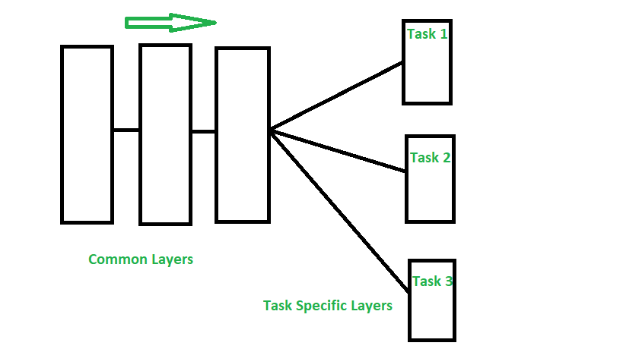
Hard parameter sharing

Slide 9
Hard parameter sharing
Hard parameter sharing greatly reduces the risk of overfitting. In fact, showed that the risk of overfitting the shared parameters is an order N -- where N is the number of tasks -- smaller than overfitting the task-specific parameters, i.e. the output layers.
This makes sense intuitively: The more tasks we are learning simultaneously, the more our model has to find a representation that captures all of the tasks and the less is our chance of overfitting on our original task.

Slide 10
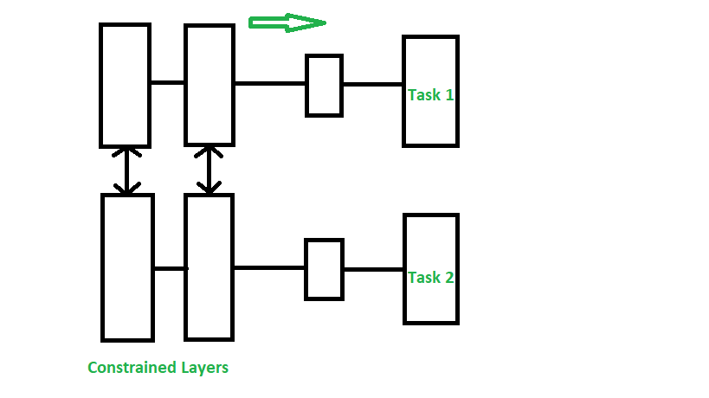
Soft Parameter Sharing
Each model has their own sets of weights and biases and the distance between these parameters in different models is regularized so that the parameters become similar and can represent all the tasks.

Slide 11
Soft Parameter Sharing
In soft parameter sharing on the other hand, each task has its own model with its own parameters. The distance between the parameters of the model is then regularized in order to encourage the parameters to be similar.
The constraints used for soft parameter sharing in deep neural networks have been greatly inspired by regularization techniques for MTL that have been developed for other models.

Slide 12
Applications:
MTL techniques have found various uses, some of the major applications are-
Object detection and Facial recognition
Self Driving Cars: Pedestrians, stop signs and other obstacles can be detected together
Multi-domain collaborative filtering for web applications
Stock Prediction
Language Modelling and other NLP applications

Slide 13
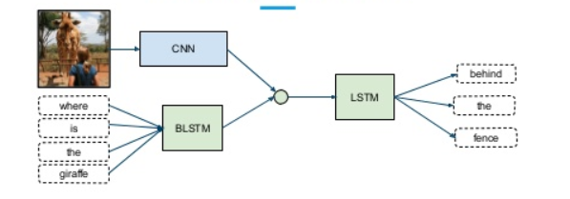
Multimodal Deep Learning
Multimodal learning helps to understand and analyze better when various senses are engaged in the processing of information.
multiple types of modalities, i.e., image, video, text, audio, body gestures, facial expressions, and physiological signals.

Slide 14
Multimodal data
Our experience of the world is multimodal — we see objects, hear sounds, feel the texture, smell odors, and taste flavors. Modality refers to the way in which something happens or is experienced and a research problem is characterized as multimodal when it includes multiple such modalities.
In order for Artificial Intelligence to make progress in understanding the world around us, it needs to be able to interpret such multimodal signals together.

Slide 15
Multimodal Deep Learning
Though combining different modalities or types of information for improving performance seems intuitively appealing task, but in practice, it is challenging to combine the varying level of noise and conflicts between modalities.
Moreover, modalities have different quantitative influence over the prediction output.
The most common method in practice is to combine high-level embeddings from the different inputs by concatenating them and then applying a softmax.

Slide 16
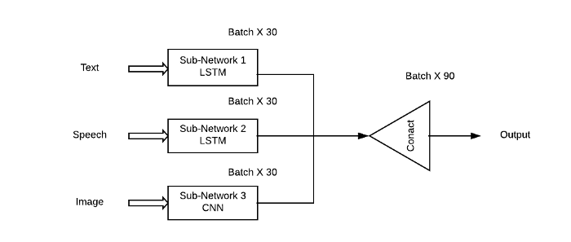
Example of Multimodal deep learning where different types of NN are used to extract features
The problem with this approach is that it would give an equal importance to all the sub-networks / modalities which is highly unlikely in real-life situations.

Slide 17

Weighted Combination of Networks
We take a weighted combination of the subnetworks so that each input modality can have a learned contribution(Theta) towards the output prediction.
Our optimization problem becomes -
Loss Function after Theta weight is given to each sub-network.

Slide 18
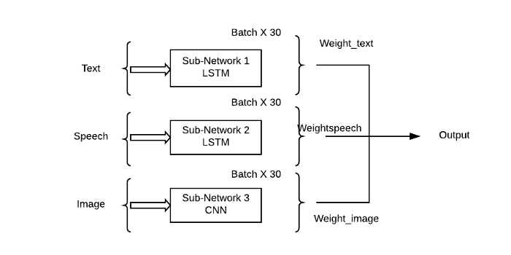
The output is predicted after attaching weights to the subnetworks.

